Slide 1
July 17, 2015
FUNimation VoC Results
July 6 – July 24
Creative
David Batten
Sr. UX Architect

Slide 2
Research Objectives
Why are we doing the survey?
To establish a baseline of operation to compare with future website enhancements
To measure impact of future changes on NPS and ROI
To identify areas of opportunity for optimization
What do we measure?
Metrics
Customer Demographics
Gender
Age Range
Purchase behavior
Website visitations
NPS for
Website
Streaming
Merchandise Purchase
Satisfaction with Website Navigation
Satisfaction with Website Layout/Design
Overall Satisfaction with Website
Customer Comments / Suggestions
How does this survey fit in our plan?
Data was gathered to provide a current user view of website issues/comments
This is stage 3 of our User Research Roadmap (Ongoing, Quarterly Reporting)
Gather Qualitative Data and satisfaction metrics of current FUNimation website users.
Begin setting NPS (Net Promoter Score) baseline for current users in order to gauge ROI (Return on Investment) for upcoming website changes
Gather customer comments so they may be categorized and rank ordered with respect to their frequency.

Slide 3
Task Selection
Research Objectives
Fifteen Questions
What is your Gender?
Which range includes your age group?
How long have you used the FUNimation website?
How frequently do you purchase FUNimation products or services?
How did you learn of our website?
How often do you visit our website?
On your last visit, what was your primary reason for visiting our website?
How likely is it that you would recommend this website to a friend or colleague?
How likely is it that you would recommend FUNimation streaming services to a friend or colleague?
How likely is it that you would recommend FUNimation Anime DVDs/Blu-rays to a friend or colleague?
On a scale of 1 to 7 where 7 is Very Satisfied and 1 is Not Satisfied At All, how satisfied are you with our website’s Ease of Navigation? Why?
On a scale of 1 to 7 where 7 is Very Satisfied and 1 is Not Satisfied At All, how satisfied are you with our website’s Layout/Design? Why?
On a scale of 1 to 7 where 7 is Very Satisfied and 1 is Not Satisfied At All, how satisfied are you with our website’s ability to meet your needs? Why?
Do you have any other suggestions on how we can improve the website for you?
Gather Qualitative Data and satisfaction metrics of current FUNimation website users.
Begin setting NPS (Net Promoter Score) baseline for current users in order to gauge ROI (Return on Investment) for upcoming website changes
Gather customer comments so they may be categorized and rank ordered with respect to their frequency.

Slide 4
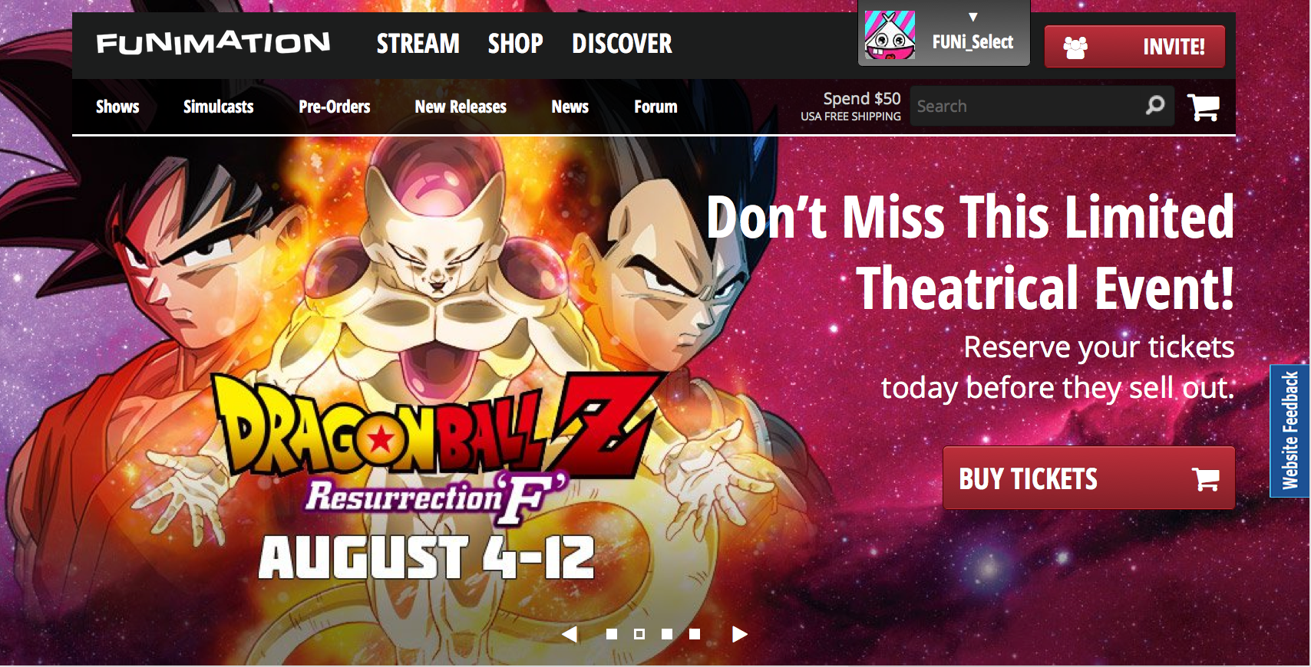
Methodology
Self-Selected VoC Survey
Designed survey in UserZoom
Integrated into website as a feedback tab
Users Choose to enter feedback
Some provide generic feedback
Some provide specific feedback based on the page they are currently on
Survey results are from July 6, 2015 – July 27, 2015
Number of surveys collected = 500
“Website Feedback”

Slide 5
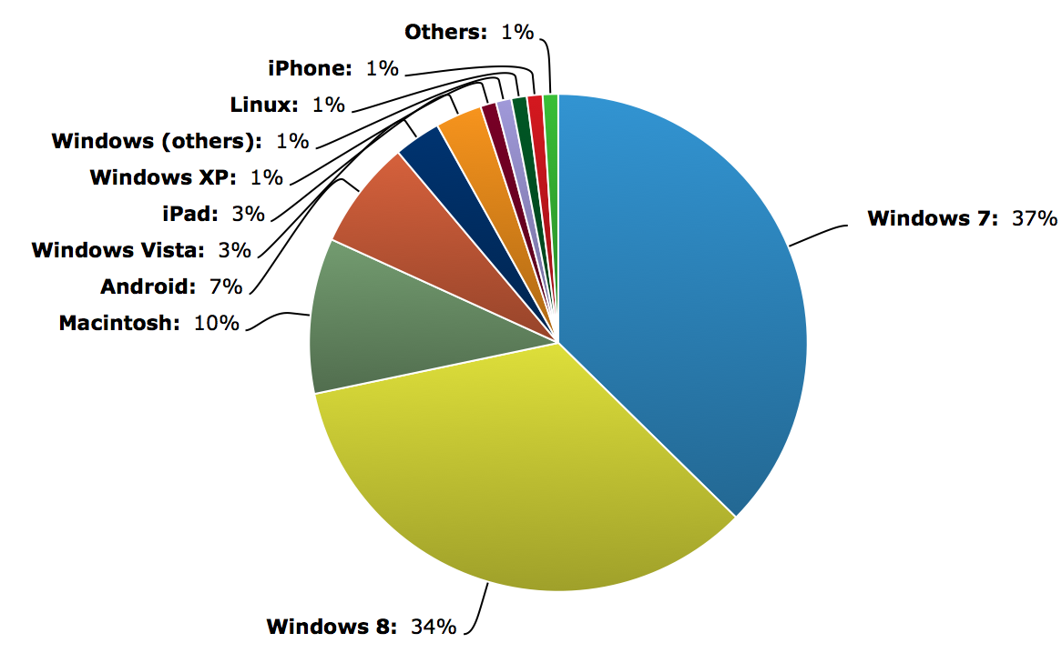
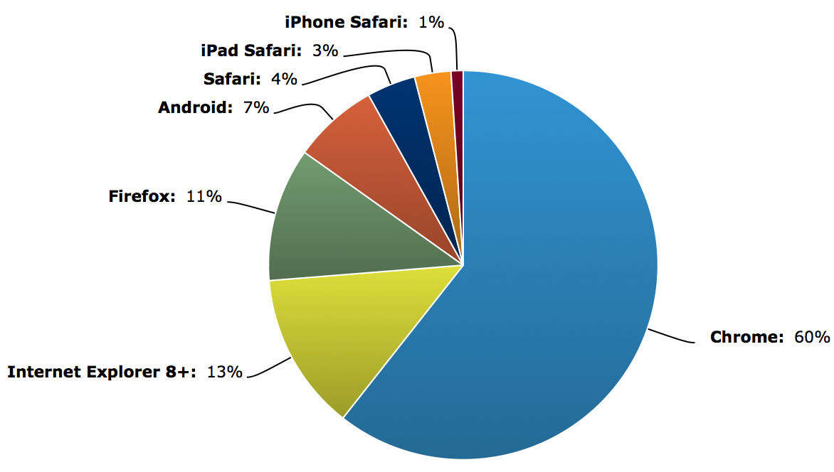
OS / Browser Usage
Windows 7 & 8 OS’s Dominate
Windows 7 | 37%
Windows 8 | 34%
Macintosh | 10%
Android | 7%
Windows Vista | 3%
iPad | 3%
Windows XP | 1%
Windows (others) | 1%
Linux | 1%
iPhone | 1%
Others | 1%
Chrome Browser Dominates
Chrome | 60%
Safari | 4%
Firefox | 11%
Internet Explorer 8+ | 13%
iPhone Safari | 1%
iPad Safari | 3%
Android | 7%

Slide 6
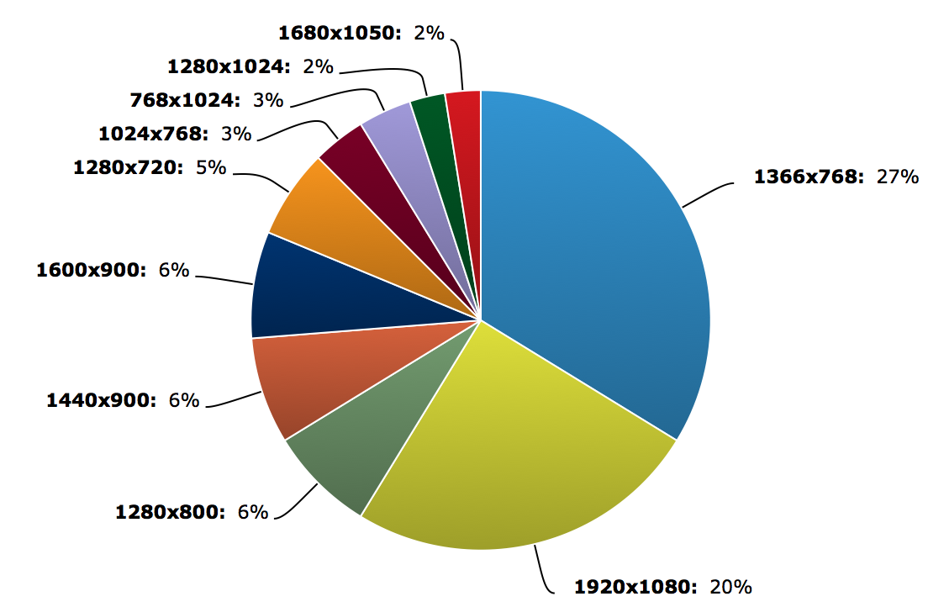
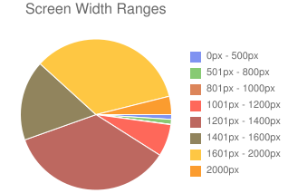
Users Screen Resolution (top 10)
Higher Resolutions Dominate
1366x768 | 27%
1920x1080 | 20%
1440x900 | 6%
1600x900 | 6%
1280x800 | 6%
1280x720 | 5%
1024x768 | 3%
768x1024 | 3%
1360x768 | 2%
854x534 | 2%
General Population Screen Width Ranges
https://css-tricks.com/screen-resolution-notequalto-browser-window/

Slide 7
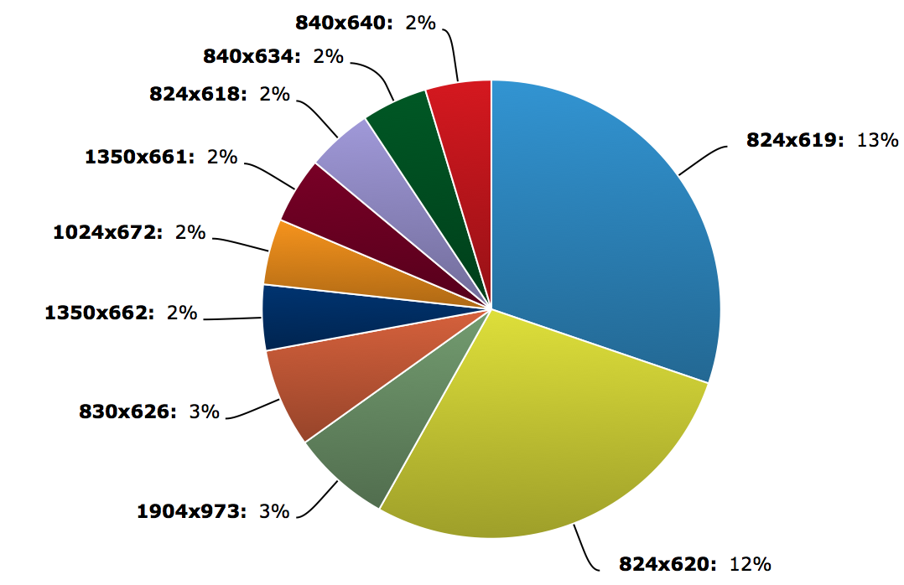
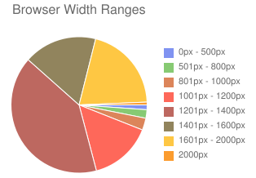
Users Browser Resolution (top 10)
Window Width < 900px Dominates
824x619 | 13%
824x620 | 12%
830x626 | 3%
1904x973 | 3%
1350x661 | 2%
840x634 | 2%
1350x662 | 2%
824x618 | 2%
840x640 | 2%
1024x672 | 2%
General Population Screen Width Ranges
https://css-tricks.com/screen-resolution-notequalto-browser-window/

Slide 8
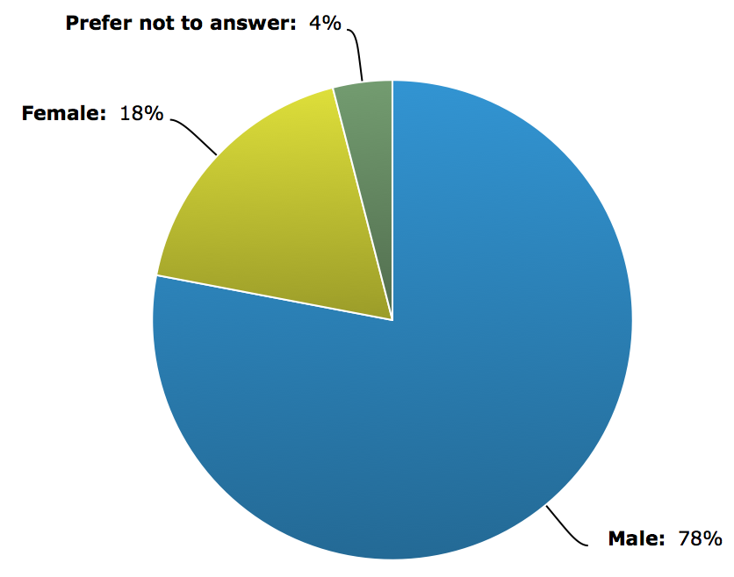
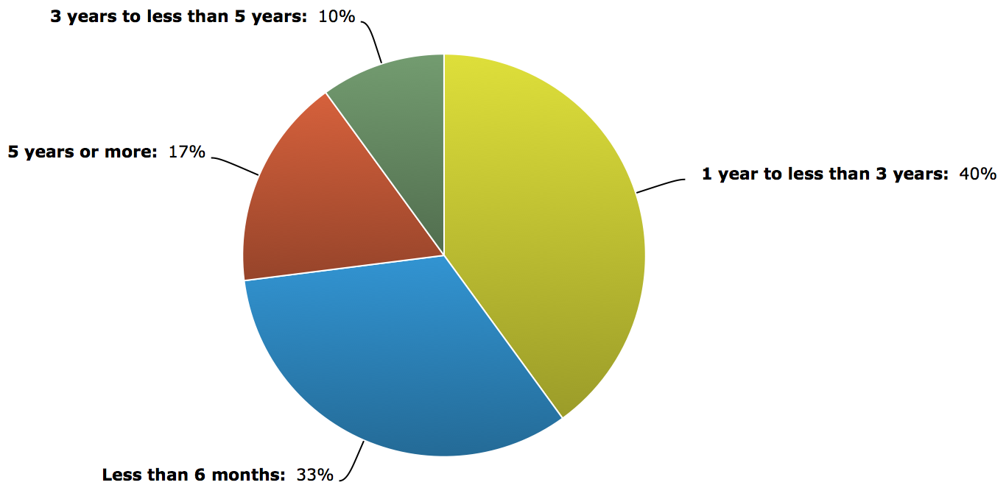
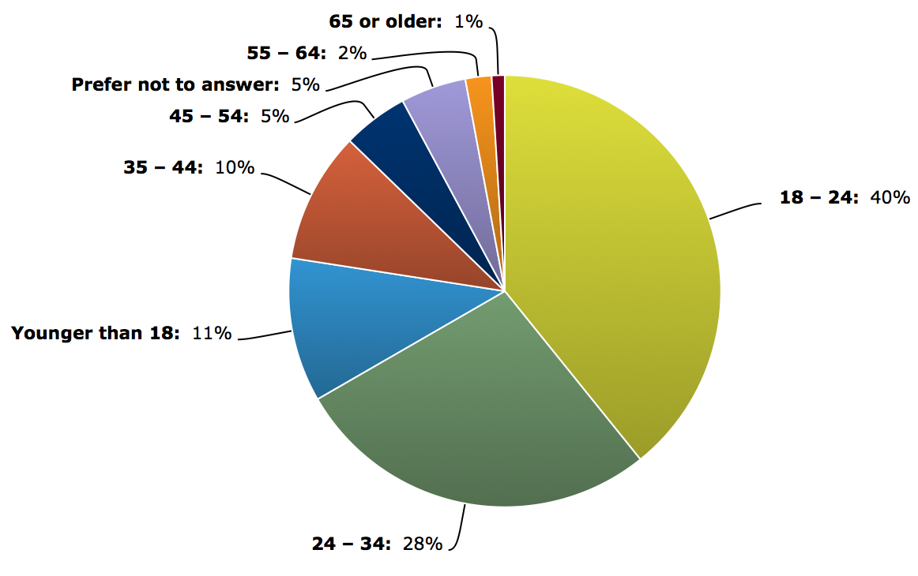
Demographics
Gender | %
Male | 78
Female | 18
Other | 4
Age Range | %
< 18 | 11
18 - 24 | 40
24 - 34 | 28
35 - 44 | 10
45 - 54 | 5
55 - 64 | 2
Other | 6
Usage (Length of Time) | %
< 6 Months | 33
6 Months to 3 Years | 40
3 to 5 Years | 10
> 5 Years | 17

Slide 9
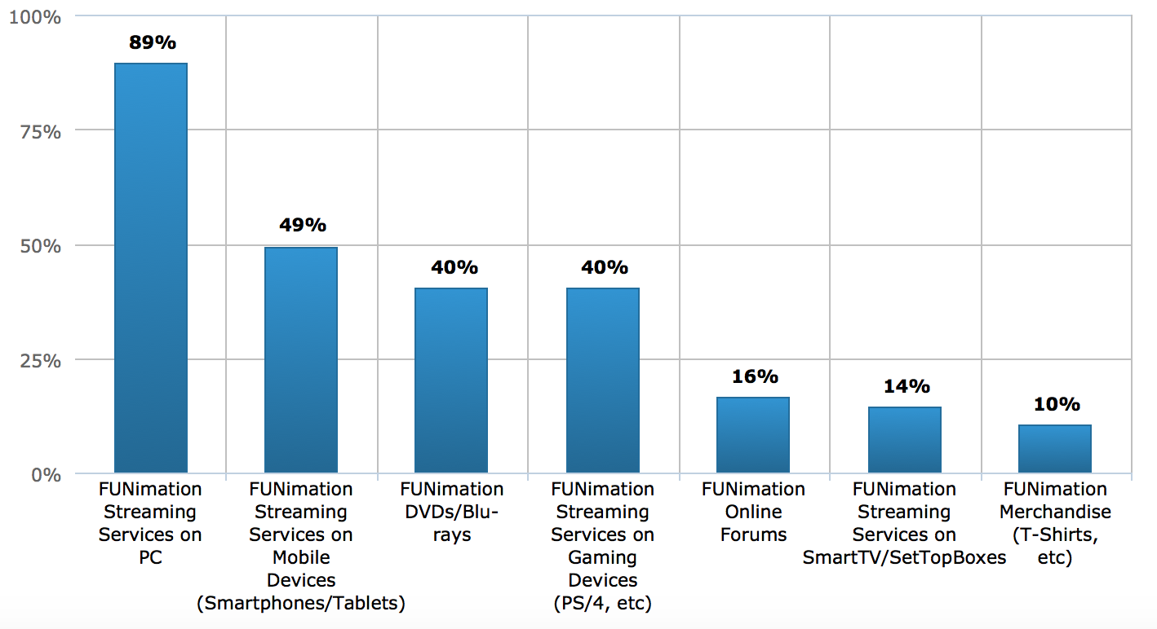
FUNimation Products / Services Used (check all that apply)

Slide 10
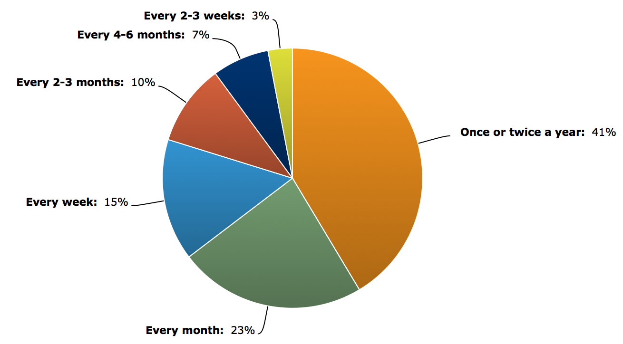
Frequency of Purchases

Slide 11
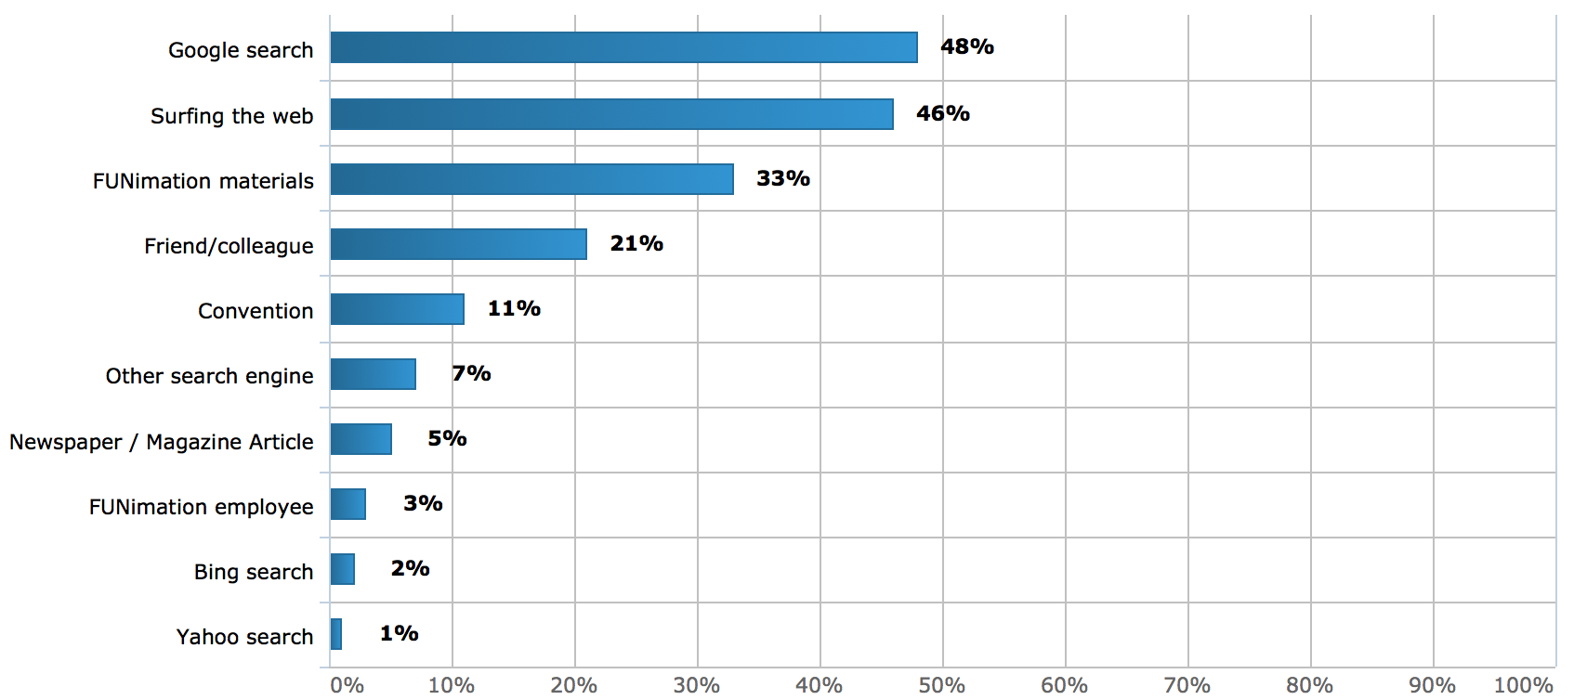
Drivers to the Website

Slide 12
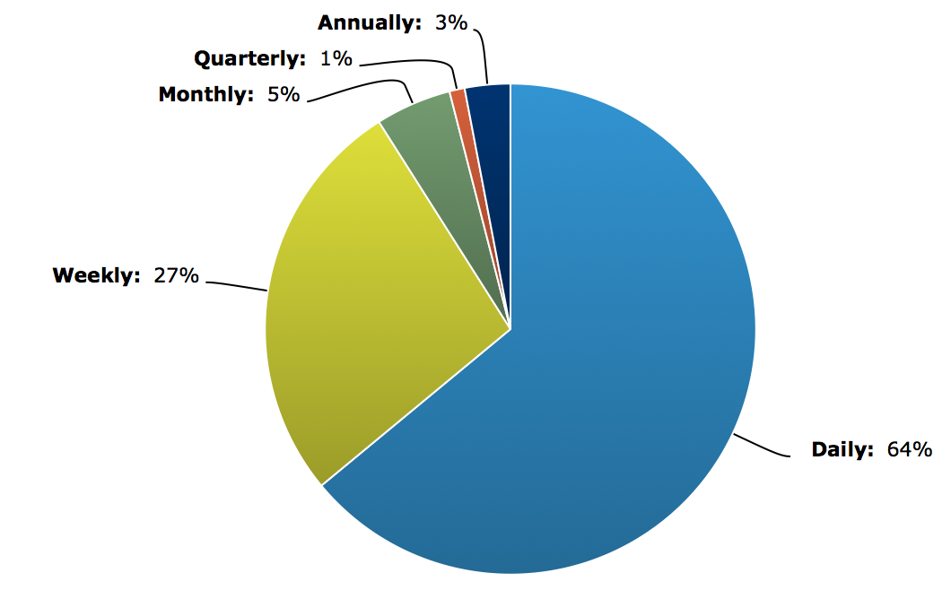
Frequency of Website Visitation

Slide 13
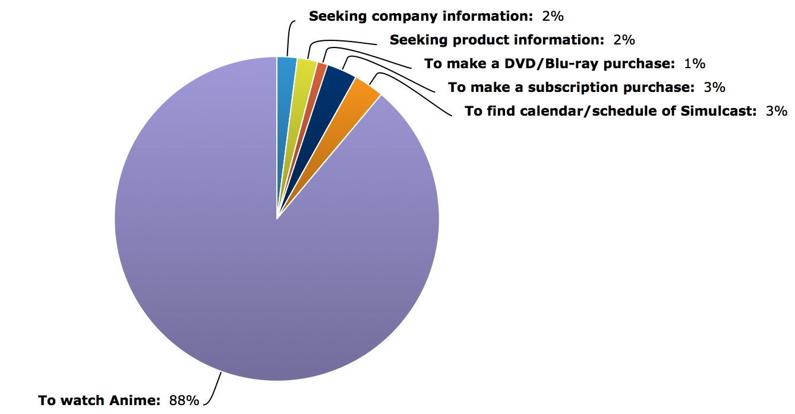
Primary Reason for Website Visitation (last visit)

Slide 14
NPS Scores* (-100 to +100 range)
Metric | Total Survey N=500 | New Users N=317** | < 6 Month Users N=166 | 6 Month to < 3 Year Users N=201 | 3 to 5 Year Users N=50 | 5+ Year Users N=83 | Comparison Metric | Notes
NPS (website) | +31 | -14 | 23 | 37 | 30 | 29 | -14 | Generic websites
NPS (watch streaming service) | +34 | -- | 29 | 40 | 39 | 33 | +56 | Best of Breed (Pandora/Netflix)
NPS (purchase DVDs/Blu-rays, Merchandise) | +8 | -- | -10 | 16 | 2 | 30 | +64 | Best of Breed (Amazon/Zappos)
** Value from New User Baseline Test
Whereas the FUNimation website is on par with a ‘generic’ website for first time users who have not established a loyalty to the product/company, it significantly lags behind the ‘Best of Breed’ for Streaming and Purchasing among loyal customers
*The Net Promoter Score is an index ranging from -100 to +100 that measures the willingness of customers to recommend a company’s products or services to others. It is used as a proxy for gauging the customer’s overall satisfaction with a company’s product or service and the customer’s loyalty to the brand.
It costs a company much more money to win back a detractor as opposed to keeping promoters.
The reverse is true with a customer enthusiast and promoter. They’ll buy more from the company they love, they’ll need less customer service and will refer friends and relatives. Free publicity from a promoter means the company need not spend as much on marketing and advertising.

Slide 15
User Satisfaction
Metric | Total Survey Mean* N=286 | Total Survey % (Satisfied or Very Satisfied) | < 6 Month Users % / Mean N=166 | 6 Month to < 3 Year Users % / Mean N=201 | 3 to 5 Year Users % / Mean N=50 | 5+ Year Users % / Mean N=83 | Comparison Metric Mean (50th Percentile)
Website Ease of Navigation | 5.2 | 51% | 47 / 5.1 | 56 / 5.3 | 56 / 5.4 | 48 / 5.1 | 5
Website Layout / Design | 5.4 | 59% | 54 / 5.3 | 60 / 5.5 | 68 / 5.6 | 58 / 5.2 | 5
Website meets your Needs | 5.5 | 61% | 61 / 5.4 | 64 / 5.6 | 60 / 5.4 | 60 / 5.5 | 5
* Out of a 7 point scale
The FUNimation website consistently hovers around the 50th percentile for user satisfaction of Navigation and Layout/Design with the general trend being that users tend to be more satisfied the longer they use (learn) the website.

Slide 16
Comments Analysis
Negative Comments
Positive Comments
% of Responses
Topical Area
Topical Area
Navigation, Layout, Design – Taxonomy, Clutter, Visuals, Business Silos
Content – Subs, Dubs, Series Info, More Shows
Video Player – Features, Functions, Enhancements
Search, Filter & Sort – All Inclusive Search, Scoped Search, Filter & Sort Behavior, Multiple Search fields on pages
Streaming – Bandwidth Issues, Buffering, Stream Drops
Apps – Features, Functions, Enhancements, Pay vs Free Apps, Apps for other platforms (Apple TV)
Queue – Enhancements, Visibility
Ads – Popup ads (DBZ), Subscriber getting HULU player or Free Player w/ Ads on certain shows, “Spotlights” size
General – General non specific compliment (ie., “You’ve improved so MUCH since the last website”)
Navigation, Layout, Design – No problems finding things, like the layout
Content – Love the amount of content
Streaming – Love the device streaming, love the quality
Customer Service – Good encounters with CS persons

Slide 17
Take-Aways
When Respondents have an opinion on an area of the website, the negative comments are 8% to 14% greater than positive comments
The FUNimation website consistently hovers around the 50th Percentile for the User Satisfaction of Navigation and Layout/Design with the general trend being that users tend ot be more satisfied the longer they use (learn) the website
Whereas the FUNimation website is on par with a ‘generic’ website for first time users who have not established a loyalty to the product/company, it significantly lags behind the ‘Best of Breed’ for Streaming and Purchasing among loyal customers
39% of respondents make a FUNimation purchase every month, with 15% purchasing every week
Main drivers to the website for respondents are Google Searches and Surfing the web in general (website drivers)
91% of respondents visit the FUNimation website at least every week with 65% visiting daily
89% of respondents come to the FUNimation website to stream/watch Anime

Slide 18
Next Steps
Mesh Customer Comments with Technology’s “Parking-Lot” document
Identify those issues which are currently being addressed
Meet with Technology to prioritize issues and categorize them as appropriate for phase 2 (current website enhancements), phase 3 (FUNimation 3.0) or beyond
Present a Plan/Budget for C-Suite Approval

